Slide 1
Capstone Project-SQL Amazon Sales analysis
Created By : Palak Pastagiya-S8039

Slide 2
Contents
Project overview
Project scope
Business objective
Data collection and understanding
Data dictionary
Project In MYSQL workbench
Exploratory Data Analysis(EDA)

Slide 3
Project overview
This project provides detailed information on amazon sales data which is helpful to determine different factors that affect sales of different branches.
The dataset contains sales transactions from three different branches of amazon located in Yangon(A),Mandalay(B),Naypyitaw(C).
In this project , MYSQL workbench is used to perform product, sales and customer based analysis for amazon sales.

Slide 4
Project Scope
4
In this project, MYSQL workbench is used to create database, import dataset, analyze different factors in different areas to increase sales and to check how 3 branches of Myanmar is performing with respect to customer , sales and product analysis.
Industry: Retail
Product lines :
Food and beverages,
Health and beauty,
Sports and travel,
Fashion accessories ,
Home and lifestyle ,
Electronic accessories

Slide 5
Business objective
The business objective is to gain insight into amazon sales data to understand the different factors such as product , sales and customer based analysis that affect sales of different branches.
Conduct product analysis to understand the different product lines and how they are performing.
Conduct sales based analysis to measure the strategy the business can apply and modifications are needed to gain more sales.
Conduct customer analysis to uncover the different customer segments , purchase trends and profitability.

Slide 6
Data collection and understanding
6
Data collection: Create database in MYSQL workbench and after creating amazon table we need to import amazon dataset as csv file using Table data import wizard
Data Wrangling: This is the step to make sure null values and missing values are detected and data replacement methods are used to replace missing or null values
Feature engineering :This will help us generate some new columns from existing ones. This dataset contains 17 columns initially. For time based analysis 3 new columns named ‘timeofday’, ‘dayname’, ’monthname’ are created.

Slide 7

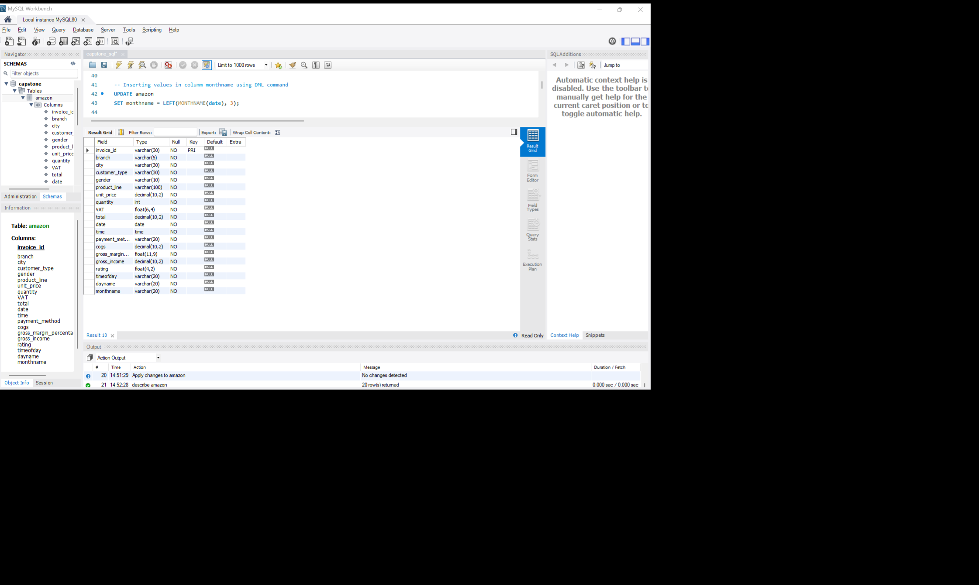
Data dictionary
Database is created
These is SQL table named amazon.
This dataset contains 17 columns initially . For further analysis 3 columns named ‘timeofday’ , ‘dayname’ , ‘monthname’ is created

Slide 8
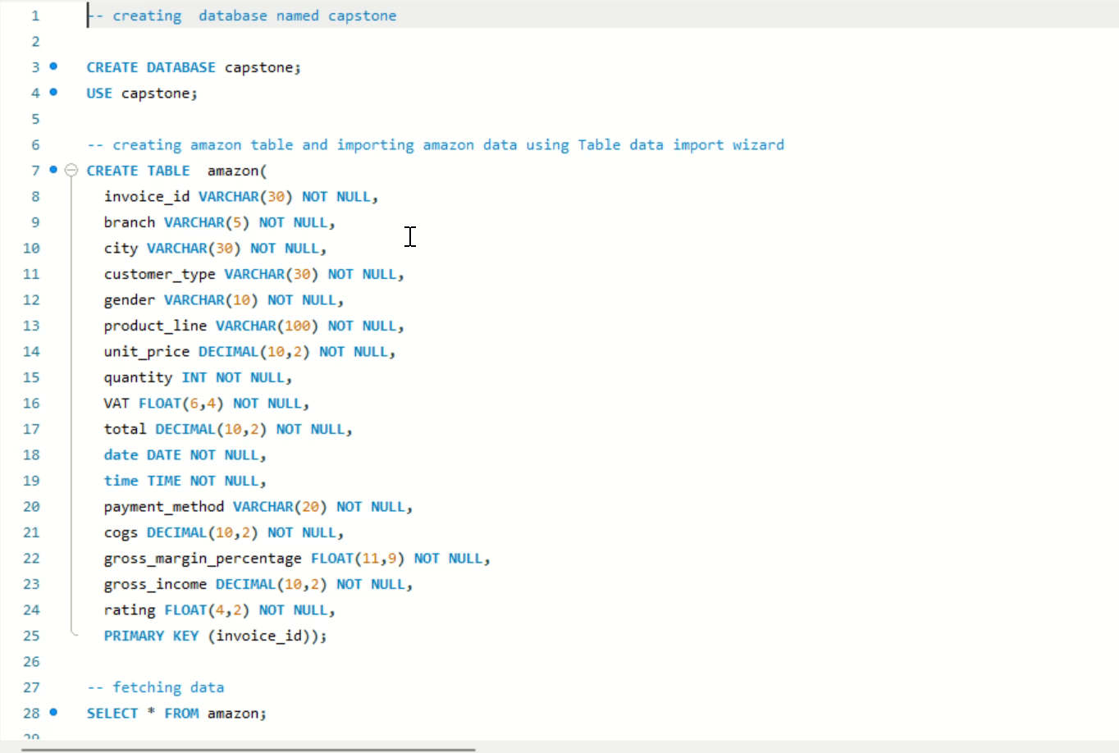
Project In MYSQL workbench

Slide 9
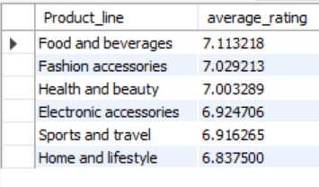
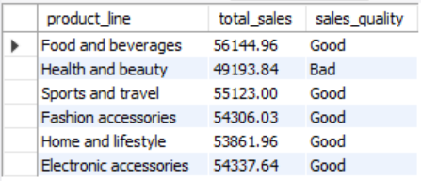
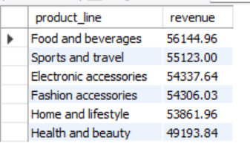
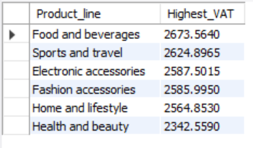
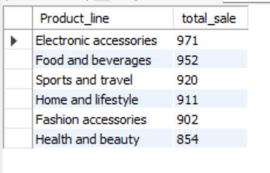
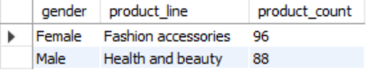
Exploratory data analysis(EDA)
Product analysis:
There are 6 product lines as shown in output (1) performed in MYSQL workbench.
Electronics accessories product line has the maximum sales whereas Health and beauty has the minimum [output(4)].
Food and beverages generated the highest sales, highest revenue, highest average rating and highest VAT [output(5)]
Most Female buy products from Fashion accessories product line whereas most male buy from Health and beauty [output (6)]
Health and beauty product line sales has to be improved as total sales are below average [output(3)]
(1)
(3)
(5)
(6)
(2)
(4)

Slide 10
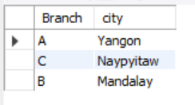
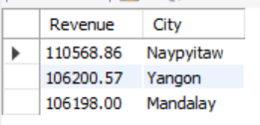
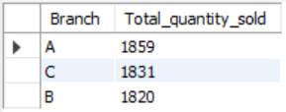
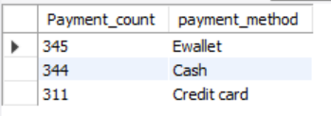
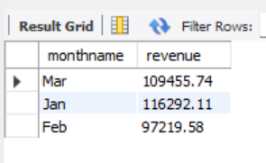
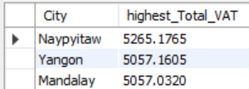
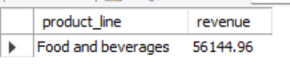
Sales analysis:
For each branch, the corresponding city is shown in output (1)
In January month revenue is highest while in Feb the revenue is lowest and in march it has been increased again[output(2)]
The city Naypyitaw generated the highest revenue and highest VAT percentage[output(3),(4)]
Branch A is doing good as it exceeded the average number whereas the product sold from branch B is lowest [output(5)]
Food and beverages generated the highest sales and highest revenue[output(6)]
Most customers are using E-Wallet payment method.[output(7)]
(1)
(3)
(5)
(7)
(2)
(4)
(6)

Slide 11
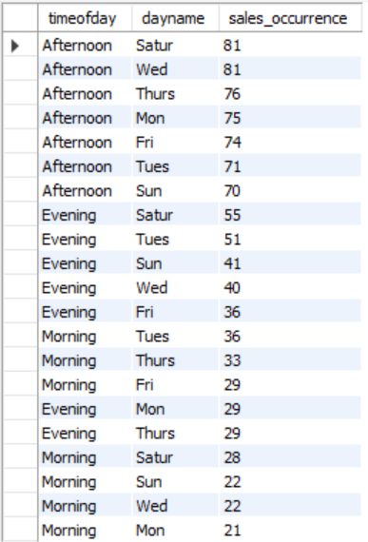
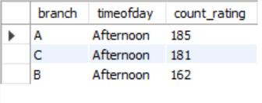
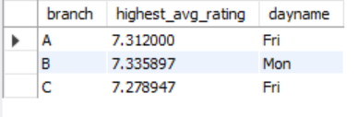
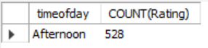
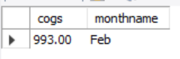
(Continued)
On Saturday and Wednesday Afternoon most sales has been occurred
shown in output (1)
Most of the customers have provided the ratings in afternoon time from
each branch [output (2),(3)]
Branch wise highest average ratings are given. [output (4)]
In Feb month the cost of goods sold reached its peak [output(5)]
(1)
(2)
(4)
(3)
(5)

Slide 12
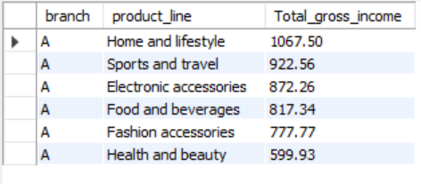
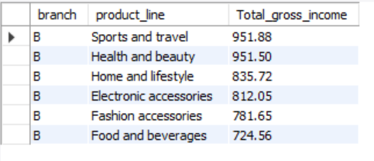
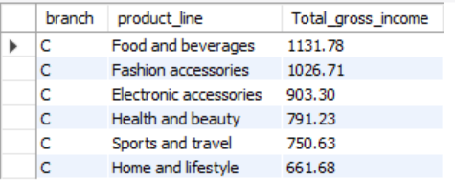
Branch based revenue and gross income
Naypyitaw city branch C has highest revenue.
In branch A the highest product line in gross income is Home and lifestyle while the lowest is Health and beauty
In branch B the highest product line in gross income is Health and beauty followed by sports
In branch C the highest product line in gross income is food and beverages while the lowest is Home and lifestyle
(1)
(2)
(3)
(4)
(5)

Slide 13
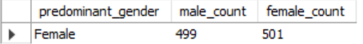
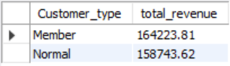
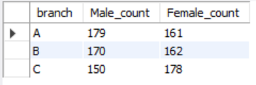
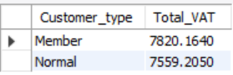
Customer based analysis
Most Females buy products from Fashion accessories product line whereas most males buy from Health and beauty [output (1)]
Most females has purchased from C branch and males from A branch.[output(2)]
Females are predominant gender in customers.[output(3)]
Among all customer type ,Members are purchasing more from amazon.[output(4),(5)]
(3)
(1)
(4)
(2)
(5)

Slide 14
Thank you

